Slide 1




Basin Scale Resilience Initiative for Ethiopia (BaSRINET) Project Overview
June 5/2025

Slide 2

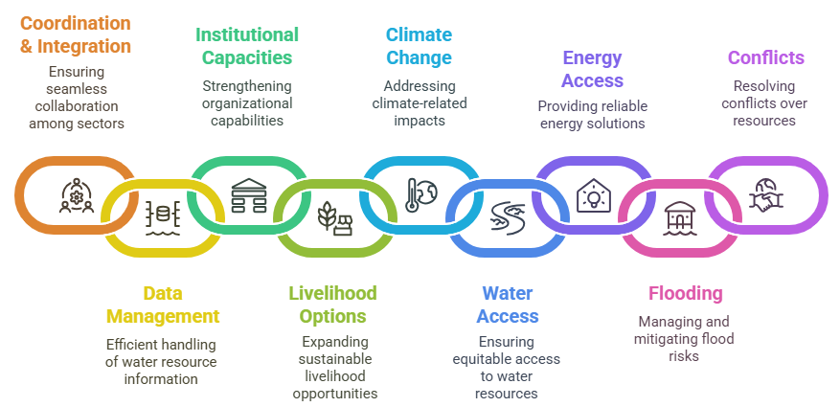
1. Why BaSRINET
Basin Scale Resilience INitiative for
EThiopia (Ba.S.R.IN.ET)

Slide 3
2. Goal and Objectives
Basin Scale Resilience INitiative for
EThiopia (Ba.S.R.IN.ET)
Project Objectives
To ensure well-organized, accurate and comprehensive hydrological basin information system;
To ensure adequate supply of water for domestic and agricultural needs
To manage selected vulnerable watersheds and protect buffer zones
To strengthen the technical, managerial and regulatory capacities of MoWE/BAOs and Regions
To develop small-scale renewable energy sources for water abstraction and other economic uses
Project Goal:
contribute to the resilience of pastoral and agro-pastoral communities´ and build sustainable livelihoods water in Awash and Wabi- Shebele basins including Denakil basins

Slide 4
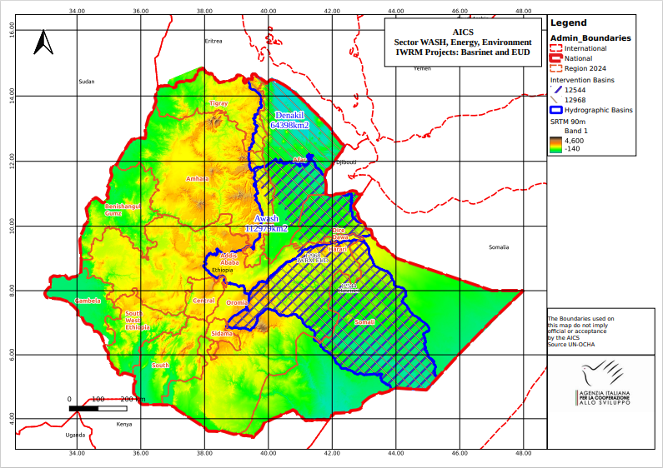
3. Project Area
Project Basins:
Awash Basin
Wabi-shebele Basin
Denakil Basin
Beneficiary
Direct 280,000 pastoral and agro-pastoral communities in Awash and Wabi-Shebele Basin
Indirect 870,000 people of the target basins

Slide 5
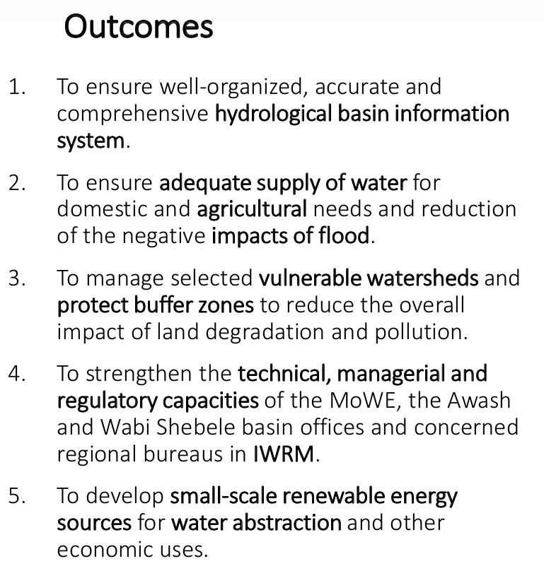
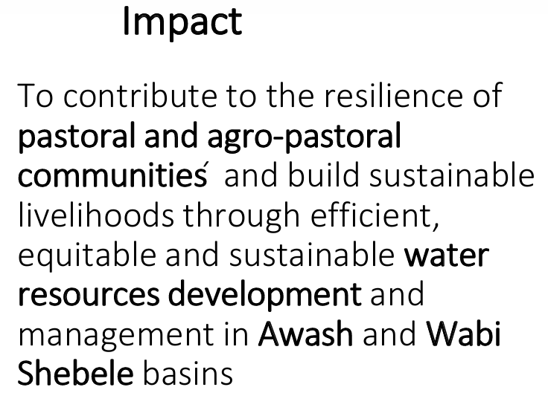
4. Outcome and Impact

Slide 6
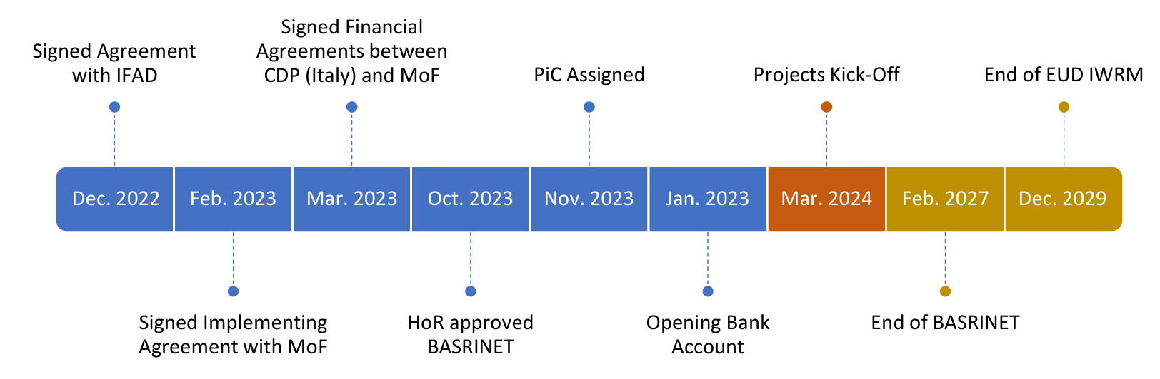
5. Timeline
Implementation Period

Slide 7
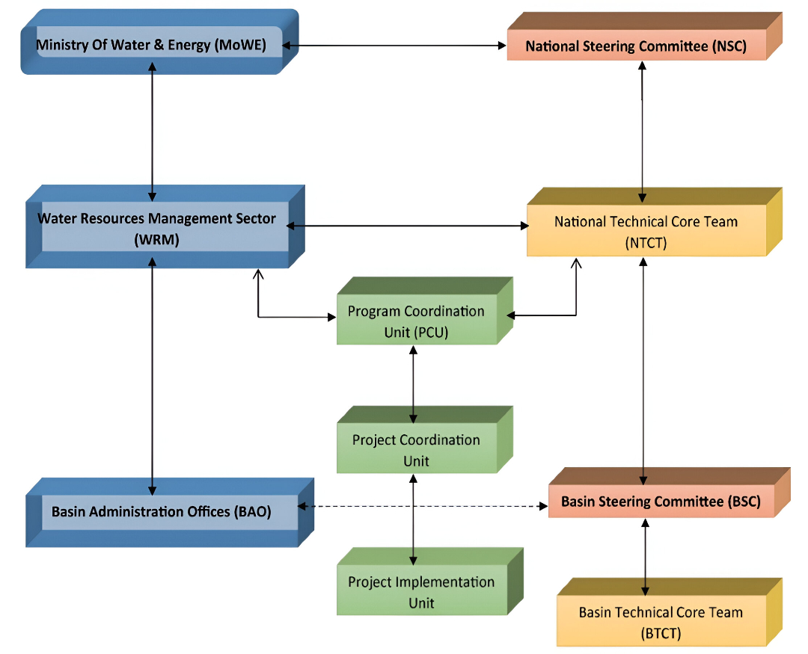
Implementation
Implementing Agencies
Ministry of Water and Energy (MoWE) _ PCU
Ministry of Agriculture (MoA)
Ministry of Irrigation and Lowlands (MILLs)
Ministry of Finance (MoF)
Italian Agency for Development Cooperation (AICS)
European Union (EU)
International Fund for Agricultural Development (IFAD)

Slide 8
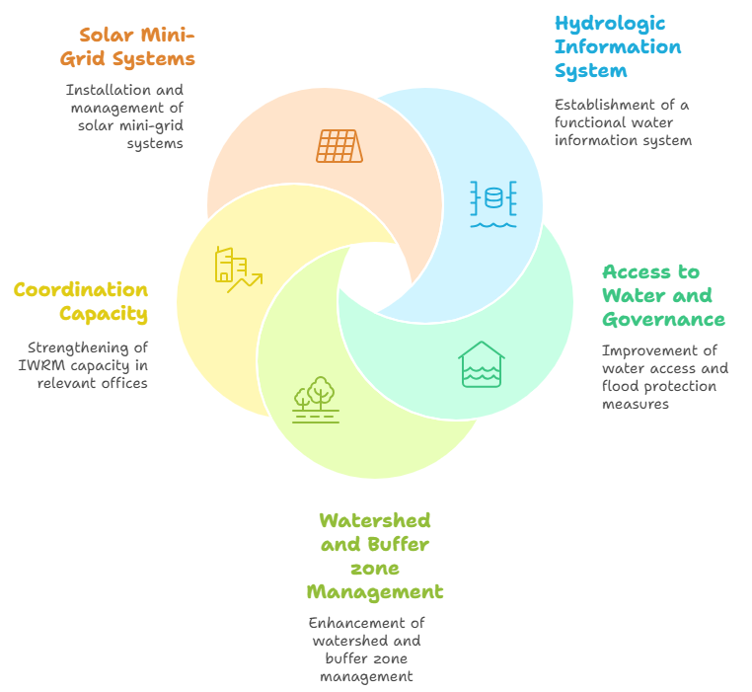



Result Areas
R 5
R 1
Basin Scale Resilience INitiative for
EThiopia (Ba.S.R.IN.ET)
R 2
R 4
R 3

Slide 9
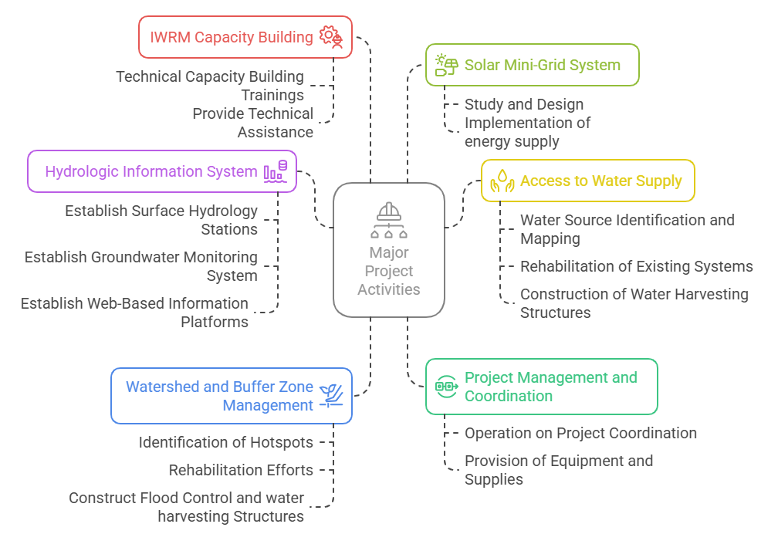
Major Activities
R 4
R 5
R 1
R 2
PCU
R 4

