Slide 1




Basin Scale Resilience Initiative for Ethiopia (BaSRINET) Project
BaSRINET Project Update
April 29/2025

Slide 2

Content
Brief Project Description
Progress Update
Key Areas of Improvement

Slide 3
1. Project Description
BAsin Scale Resilience INitiative for
EThiopia (BA.S.R.IN.ET)
Project Goal:
contribute to the resilience of pastoral and agro-pastoral communities´ and build sustainable livelihoods water in Awash and Wabi- Shebele basins|
IWRM Issues to Address:
Coordination and Sectorial Integration
WR information/data management
Institutional Capacities
Livelihood Options
Climate Change
Access to Water
Energy Access
Flooding
Conflicts

Slide 4
1. Project Description
BA.S.R.IN.ET Objective
To ensure well-organized, accurate and comprehensive hydrological basin information system;
To ensure adequate supply of water for domestic and agricultural needs
To manage selected vulnerable watersheds and protect buffer zones
To strengthen the technical, managerial and regulatory capacities of MoWE/BAOs and Regions
To develop small-scale renewable energy sources for water abstraction and other economic uses

Slide 5
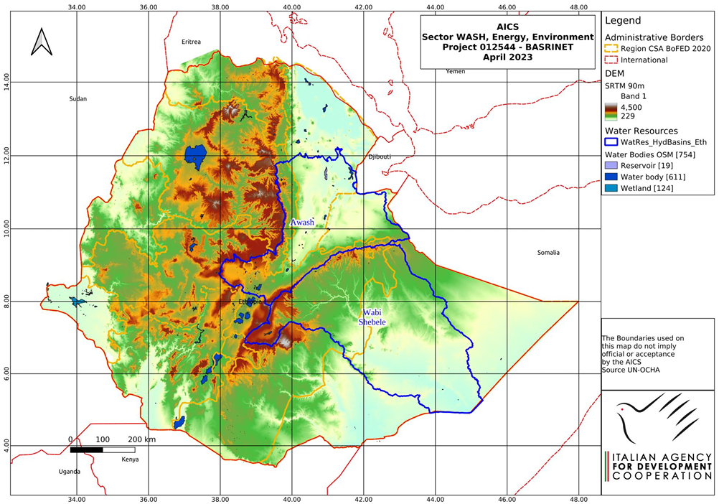
1. ….. Project Description
Project Basins:
Awash Basin
Wabi-shebele Basin
Denakil Basin (EU)
Beneficiary
Direct 280,000 pastoral and agro-pastoral communities in Awash and Wabi-Shebele Basin
Indirect 870,000 people of the target basins

Slide 6
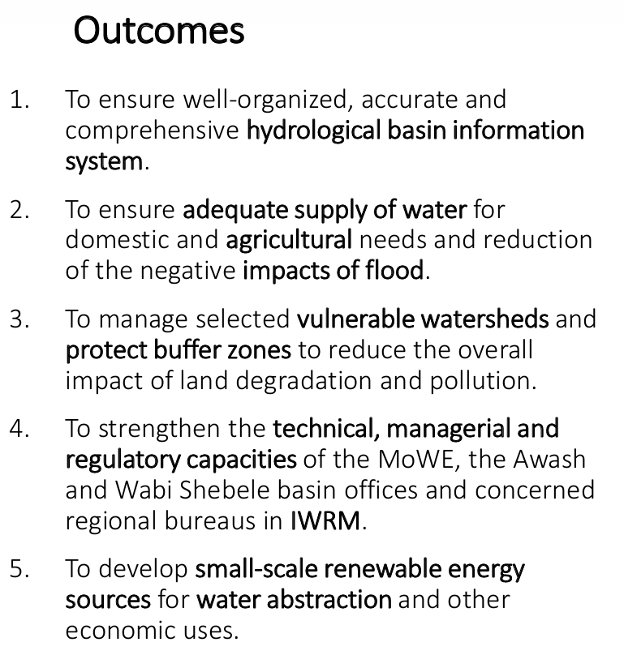
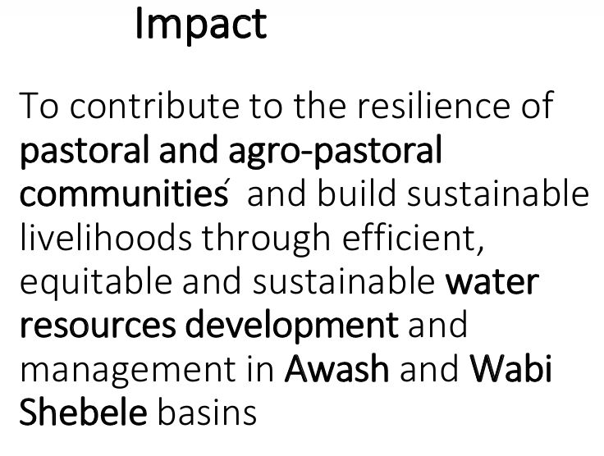
1. ….. Project Description

Slide 7
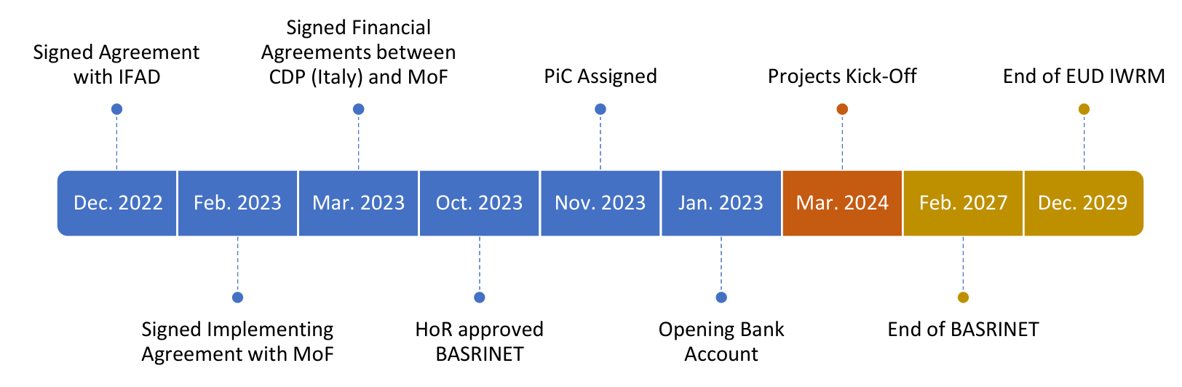
1. ….. Project Description
Implementation Period

Slide 8
1. Project Description
€ 49.5 Million
Total Budget
Executing Agency:
Ministry of Water and Energy |MoWE|
Italian Agency for Development Cooperation | AICS |
Donor:
Italian Agency for Development Cooperation |AICS|
European Union |EU|
Funds:
€ 24 Mln Soft Loan to MoWE
€ 7.5 Mln Grant to MoWE
€ 31.5 Mln total project cost (MoWE)
Release
€ 2.5 Million

Slide 9
3. Progress Update ----- Preparatory
Project submission _ 2021
Agreement … March 2023
Create Bank Accounts and Assigning Person in charge _ Nov 2023
Launching _ Mar 2024
Review BASRINET Plan of Action _ Sept 2024
Sign MoU MoWE – AICS (EU) _ Nov 2024
BaSRINET Project Staffing _ Dec 2024
BASRINET Project Staff on-boarding _ Jan 2025
Detailing the 2024/25 Plan and Consultations (MoWE)
Quick Assessment and Inception (MoWE_AICS_EU), Quick assessment (EU) _ Jan 2025

Slide 10
3. Progress Update ----- Main Tasks
The 2025 – 2027 Plan of Action for SC Endorsement
Terms of references: Five
- Seedling GLI support
- Hydrology stations including installations _ # 15
- Water supply and energy provisions planning and design
- GIS based web-portal establishment (design and installation)
- Kelafo Flood Control Implementation
3. Procurement:
- Procurement plan endorsed
- Office facility (PC and Furniture)
- Field car

Slide 11
3. Progress Update ----- Main Tasks
4. Capacity building: Training (Till Dec 2024) _ by IFAD
- Procurement and contract administration (May 2025)
- Project Management including M&E and Finance (June 2025)
- MoWE _ IWRM Capacity Development Strategy
- Project website and communication
- Harmonized IWRM Project Plan _ BRIGHT, BASRINET, FMP, HoAGW4R

Slide 12

3. Key areas of Improvement
Endorsement of the BASRINET Plan of Action by SC.
Procurement of office supplies and staffing
Project resources harmonization
Assessment, Bidding and procurement

Slide 13
Thank You

