Slide 1




Basin Scale Resilience Initiative for Ethiopia (BaSRINET)
Launching and Inception Workshop
April 15/2025

Slide 2
01
Introduction
02
Project description
03
Implementation period
04
Implementation governance structures
Outline
05
Problem to be address
06
Result based components
07
Component based three year budget
08
Progress Updates
09
next steps

Slide 3
1. Introduction
31.5 million €
24 million € Loan
7.5 million € grant
The project is designed & aligned with
Strategy:
Home Grown Economic Reform
Ten Years Perspective Development Plan
strategic plan of Wabi-Shebele and Awas
Related SDGs
AICS
The project is financed by Italian Gov.
2017FY
2024/25
2018FY
2025/26
2019FY
2026/27
Implementation Period-3Y

Slide 4
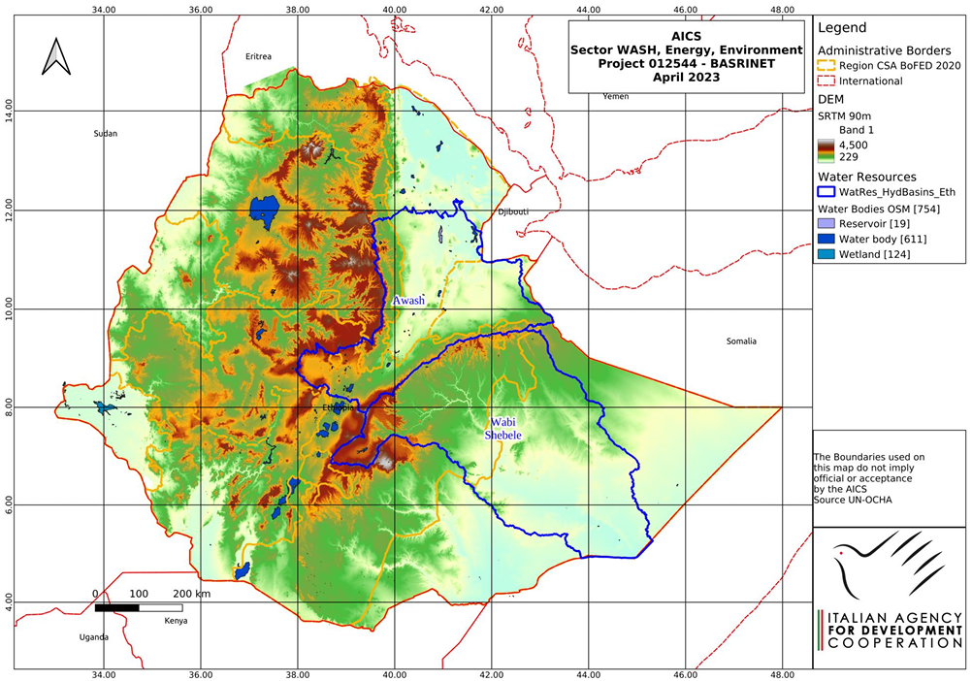
2. Project Description
Project Basins:
Awash Basin
Wabi-shebele Basin
Denakil Basin (EU)
Beneficiary
Direct 280,000 pastoral and agro-pastoral communities in Awash and Wabi-Shebele Basin
Indirect 870,000 people of the target basins

Slide 5
Cont…
€ 49.5 Million
Total Budget
Executing Agency:
Ministry of Water and Energy |MoWE|
Italian Agency for Development Cooperation | AICS |
Donor:
Italian Agency for Development Cooperation |AICS|
European Union |EU|
Funds:
€ 24 Mln Soft Loan to MoWE
€ 7.5 Mln Grant to MoWE
€ 31.5 Mln total project cost (MoWE)

Slide 6
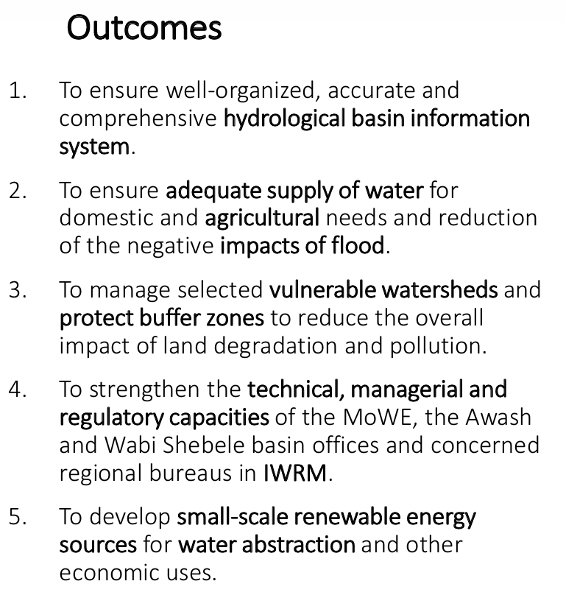
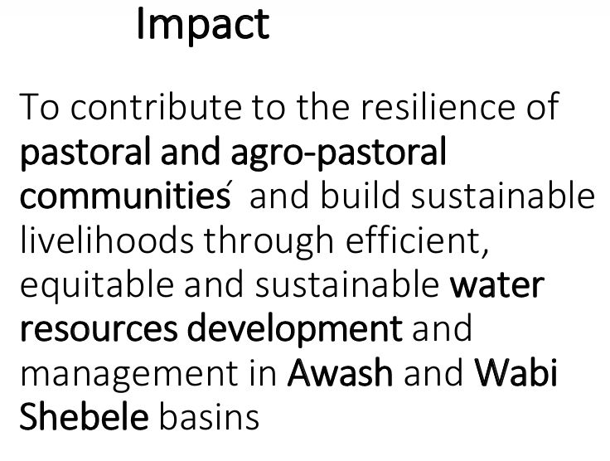
Cont….

Slide 7
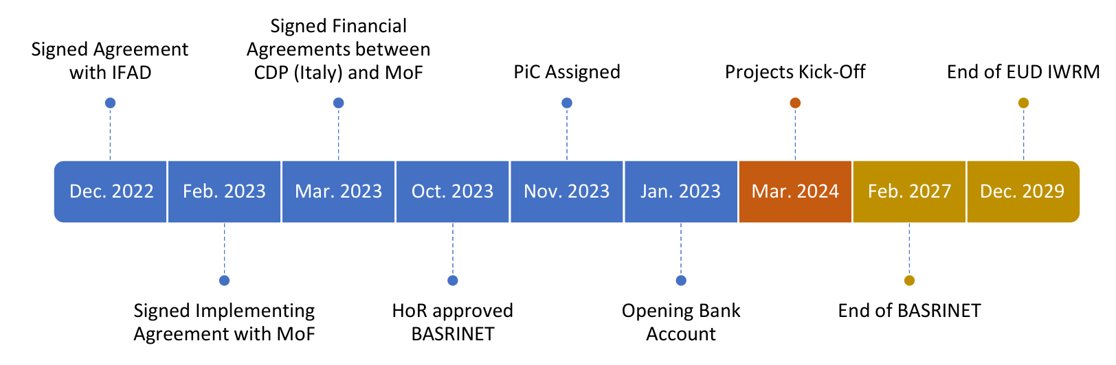
3. Implementation Period

Slide 8
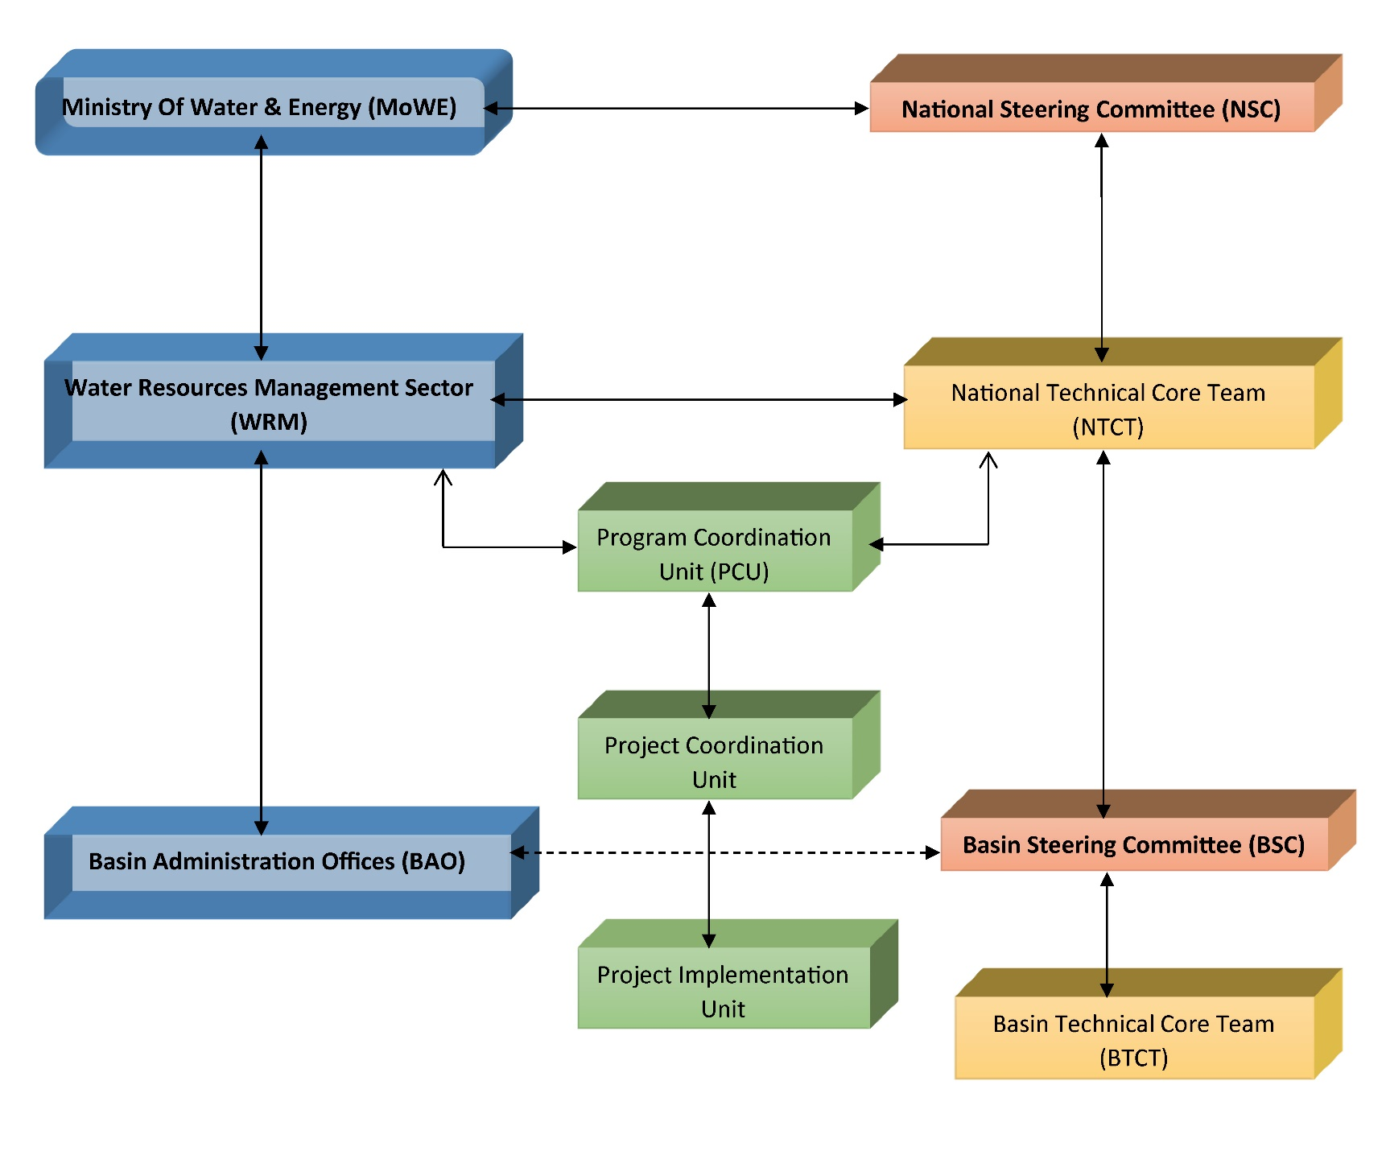
4. Project Implementation Governance Structure

Slide 9
5. Problem to be Addressed
  Scarcity of basins water resources information
  Institutional capacity
  Physical water scarcity
  Flooding
  Conflict over water resource uses
  Climate change (drought and flood exacerbated by CC)
  Energy access (etc)

Slide 10
6. Basrinet Project Result –Based Components
Result-1: Comprehensive hydrologic basin water information system is in-place and functional;
Result-2: Increased access to reliable and safe water supplies for productive and domestic uses and enhanced flood protection;
Result-3: Watershed and buffer zone management improved;
Result-4: Enhanced IWRM capacity of MoWE and Basin offices and
Result-5: Solar mini-grid systems are installed and properly managed.

Slide 11
7. Component based three year Budget
S/N | Result based components | Total project cost | Grant | Loan
1 | Project Management , Coordination and Capacity Building | 1,925,000 | 1,925,000
2 | Comprehensive hydrologic basin water information system is in-place and functional | 6,305,000 | 1,255,000 | 5,050,000
3 | Increased access to reliable and safe water supplies for productive and domestic uses and Improving water governance in the basins | 3,295,100 | 95,000 | 3,200,000
4 | Watershed and buffer zone management improved | 10,000,000 | 1,000,000 | 9,000,000
5 | Enhanced IWRM Capacity of MoWE and Basin Offices | 3,975,000 | 3,225,000 | 750,000
6 | Solar mini-grid systems are installed and properly managed | 6,000,000 | - | 6,000,000
 | Total project cost | 31,500,100 | 7,500,000 | 24,000,000

Slide 12
8. Progress Update
Project action plan prepared & reviewed including Procurement plan
Base line survey conducted for both W/Shebele & Awash basins
Intervention Site Identified
Inception report has been prepared
Project implementation manual preparation is undergoing
Trainee need assessment is conducted

Slide 13
Cont….
Procurement of hydrology gage station have been prepared and specification developed
ToR for consultancy services were prepared for activities such as: geospatial basin information system-Hardware and Soft ware specifications BHIS, ground water well, preparation for construction of two water harvesting structures, Flood control, Rehabilitation or upgrading water supply system developed(Transmission pipes, concrete ground reservoirs, water points, cattle trough, installation of electro mechanical equipment's and solar system power source).

Slide 14
Cont…
Physical soil and water harvesting structures have been identified(e.g. half bund and flood harvesting structures)
Trees & Grass species identified for biological soil and water conservation measures
Flood control Feasibility study, Design and BOQ have been developed
River canalization and dyke profile conducted for both basins ( wabishebele at kelafo and Awash basin eastern dyke at melka werer)

Slide 15

9. Next Steps
Facilitate Steering Committee meeting for the approval POA
Capacity building at all level
Implementing 100day PAO
procurement process (seedling and equipment's)
Completing Project implementation manual(PIM)
Basin implementation unit will be functional at Basin office
TORs and Specifications will be developed
Tendering and working on bids preparation

Slide 16
Thank You !

